Slide 1

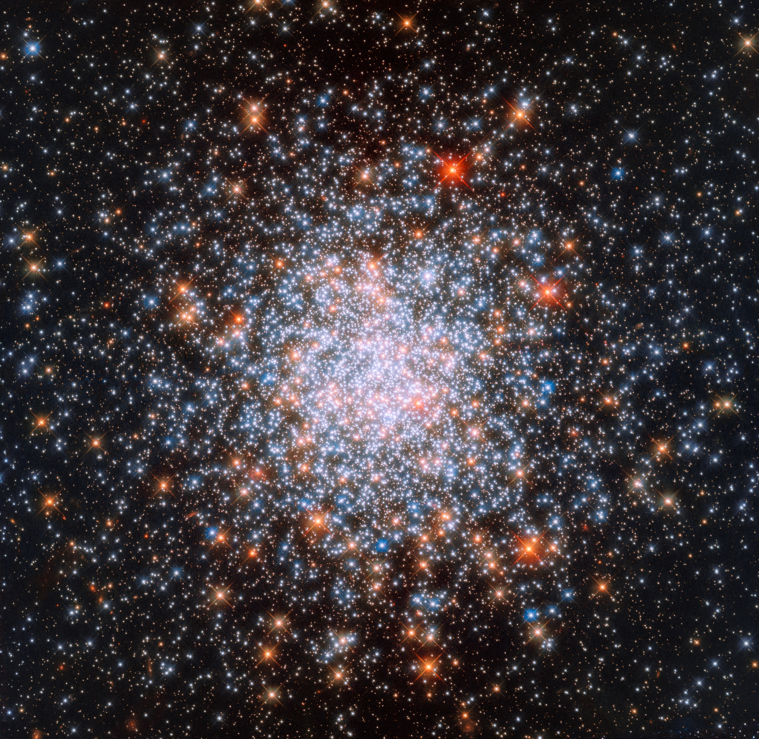
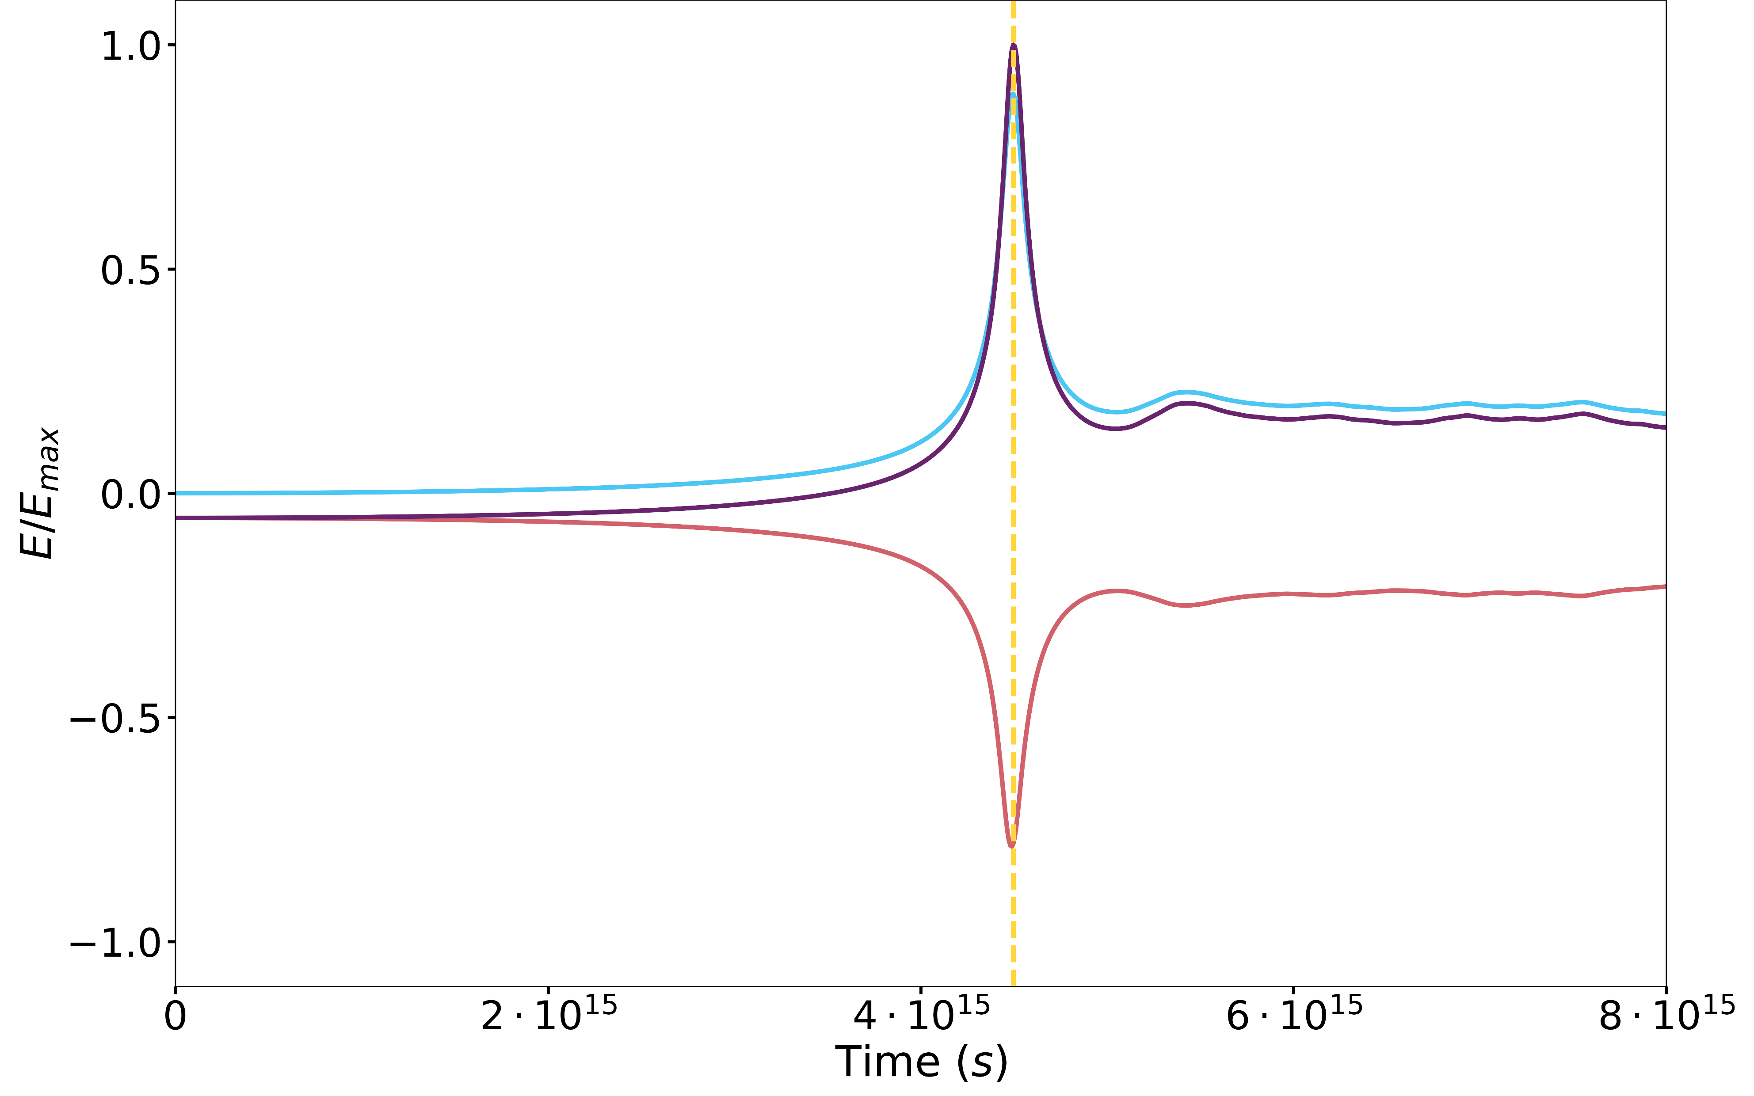
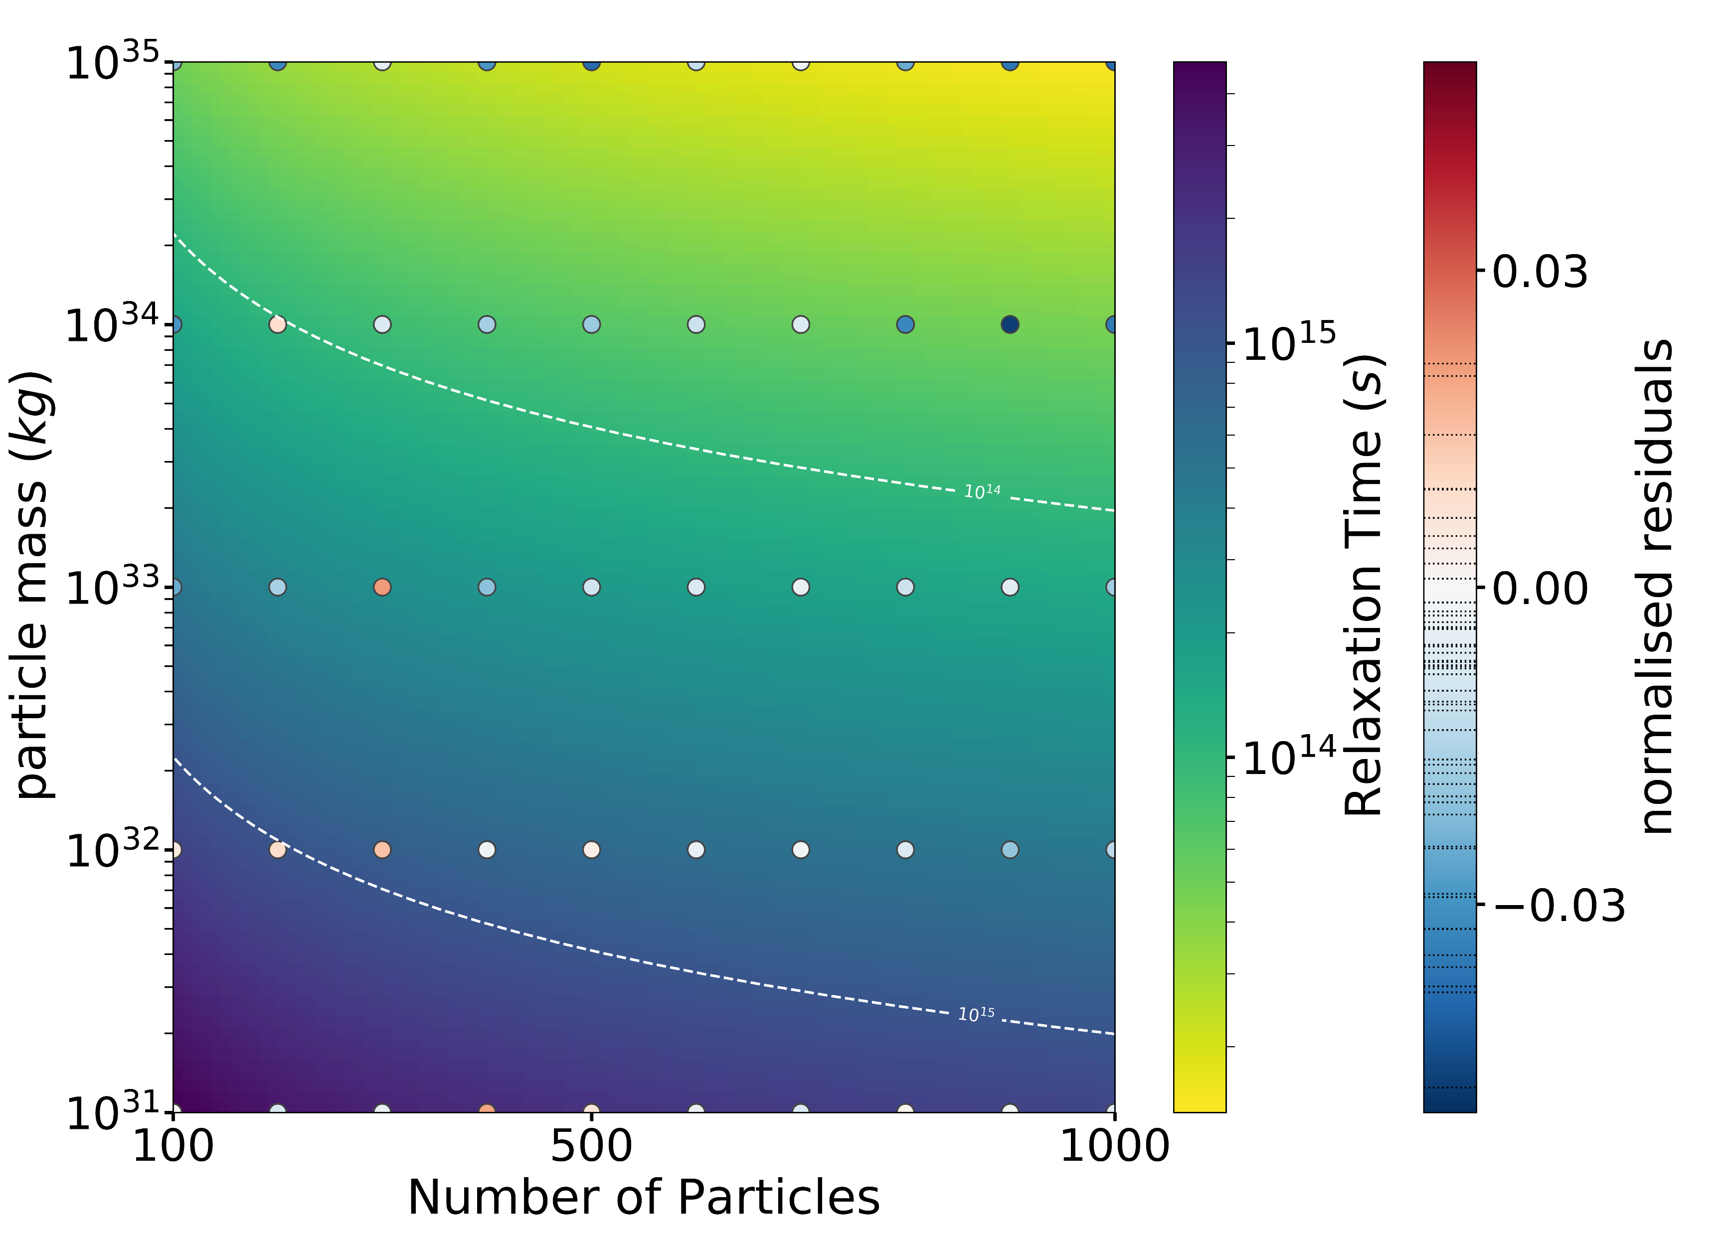
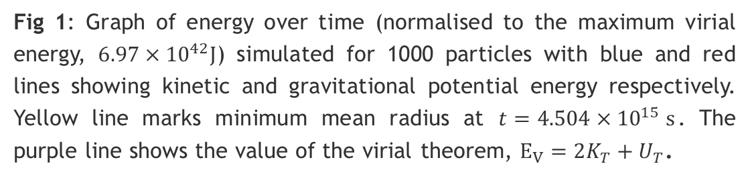


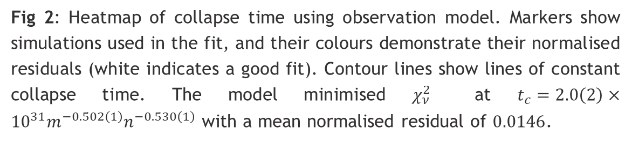
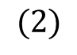

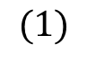
Relaxation in Globular Clusters
Jacob Kalnins
Numerical N-body simulation of stellar systems began in the 1960s^{[1]} and can offer valuable insights into Globular Clusters, groups of a few hundred thousand stars with a radius of ~1-10pc^{[2]}. This simulation method calculates the force between each pair of particles then applies a Leapfrog integration scheme to update particle positions and velocities over a given timestep. This was used to study the dynamics and evolution of globular clusters.
Theoretical Predictions
We can express relaxation time (time taken to reach equilibrium) using $σ=\sqrt{\left\langle v^{2}\right\rangle /3}$ and $ρ$ the particle mass density, as^{[3]}:
$$t_{rel}=\frac{ασ^{3}}{G^{2}mρ\ln{Λ}}$$
Where $α$ and $Λ$ are dimensionless factors which must be determined empirically. In particular, $\ln{Λ}$ is the Coulomb logarithm. Considering the half-mass relaxation time yields^{[3]}:
$$t_{rh}≈\frac{γNt_{dyn}}{\ln{λN}}$$
Here, $t_{dyn}=r_{1/2mass}^{3/2}/\sqrt{Gm}$ is the dynamical time and $λN$ approximates $Λ$. The dependence of $t_{rh}$ on particle mass $m$, and $N$ was tested. We assume that within the half-mass radius the particle density is constant, and outside the radius, it’s negligible.
$$(1)$$
Fig 1: Graph of energy over time (normalised to the maximum virial energy, $6.97×{10}^{42}J$) simulated for 1000 particles with blue and red lines showing kinetic and gravitational potential energy respectively. Yellow line marks minimum mean radius at $t=4.504×{10}^{15} s$. The purple line shows the value of the virial theorem, $E_{V}=2K_{T}+U_{T}$.
$$(2)$$
Simulation Conditions
The particles were distributed uniformly according to a 3D Poisson Disk sampling^{[4]} method in a sphere of ${r=10}^{18}m$. The particles begin at rest, and the simulation timestep is set to balance error with processing time. The system initially collapses due to its excess gravitational potential energy (see Fig. 1), then settles over time to an approximate equilibrium state. It was assumed that the energy peak linearly correlates to half-mass relaxation time, $t_{rh}$.
Fig 2: Heatmap of collapse time using observation model. Markers show simulations used in the fit, and their colours demonstrate their normalised residuals (white indicates a good fit). Contour lines show lines of constant collapse time. The model minimised $χ_{ν}^{2}$ at $t_{c}=2.0\left(2\right)×{10}^{31}m^{−0.502\left(1\right)}n^{−0.530\left(1\right)}$ with a mean normalised residual of $0.0146$.
Results & Further Research
The results were fitted to two models using scipy. The first was suggested to be of the form $t=am^{−b}n^{−c}$ (Model I). The second followed Eq. 2: $t=αm^{−β}n/\ln{γn}$ (Model II). Model I (Fig 2) was accurate, with $χ_{ν,min}^{2}=4.63$. Model II was found to be inaccurate with large $χ_{ν,min}^{2}$. However, Giersz & Heggie’s^{[5]} value of $λ$ was found to be accurate ($λ_{II}=0.113(2)$). Although $χ_{I}^{2}$ is small, the model fit may be inaccurate for high masses and low numbers. To keep conditions constant, the timestep was not varied, which became an issue due to the smaller number of steps needed to simulate the system in these cases, so uncertainty in these parameters may be underestimated. The relation between the peak and predicted relaxation time may also be investigated further.
Top image: Globular Cluster NGC 1866 – ESA/Hubble and NASA
[1] Aarseth, S.J., 1999. From NBODY1 to NBODY6: The growth of an industry. Pub. of the Astronomical Society of the Pacific, 111(765), p.1333.
[2] Talpur, J., 1997, A Guide To Globular Clusters, Keele University, retrieved 4th Feb 2020
[3] Meiron, Y. and Kocsis, B., 2018. Diffusion and mixing in globular clusters. The Astrophysical Journal, 855(2), p.87.
[4] Cook, R.L., 1986. Stochastic sampling in computer graphics. ACM Transactions on Graphics (TOG), 5(1), pp.51-72.
[5] Giersz, M. and Heggie, D.C., 1994. Statistics of N-body simulations–I. Equal masses before core collapse. M.N.R.A.S., 268(1), pp.257-275.

